Slide 1


Lunch and Learn:
Pursing scholarly activity without overburdening your schedule
September 15, 2022
Amanda Brooks, PhD
Director of Research and Scholarly Activity
Associate Professor of Molecular Biology

Slide 2
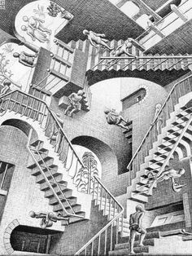
Learning Objectives
Define scholarly activity
Identify barriers
Develop a personal strategy
Crowdsource solutions

Slide 3
What is Scholarly Activity?
Teaching
Binds the activity of teaching with the activity of discovery
Discovery
Scientific discovery adds to generalizable knowledge
Integration
Active and intentional reconciliation of isolated facts
Application
Application of knowledge to practical problems
Public Dissemination
Peer Evaluation
Boyer Model 1990

Slide 4
Scholarly Activity
Research and scholarly activity can build on your clinical work and teaching – Does NOT have to be bench research
Clinical Work
Research
Teaching
A Winning Combination: Basic/Clinical Science Research and the Scholarship of Teaching and Learning https://www.ncbi.nlm.nih.gov/pmc/articles/PMC2933021/

Slide 5

Barriers
Challenges to doing “scholarly activity”:
  Just another chore
    Personal – motivation, conflicts, inertia, TIME
      Lifelong learning
      Curiosity
    Infrastructure – financial, training, mentors
      Internal grants (next deadline is October 15th)
      BMJ training modules
      Register to become a faculty peer mentor

Slide 6

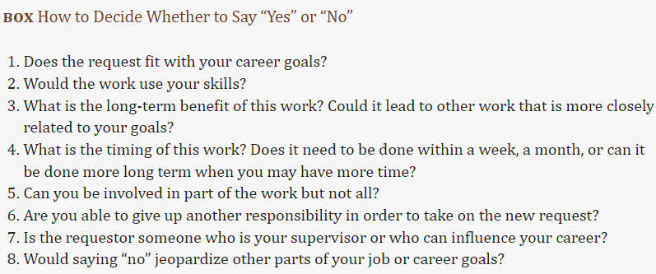
Strategies to Increase Scholarly Productivity
To-Do Lists
Learning to say “no”
  Try not to say “yes” or “no” on the spot
Getting More Done: Strategies to Increase Scholarly Productivity https://www.ncbi.nlm.nih.gov/pmc/articles/PMC4763375/

Slide 7
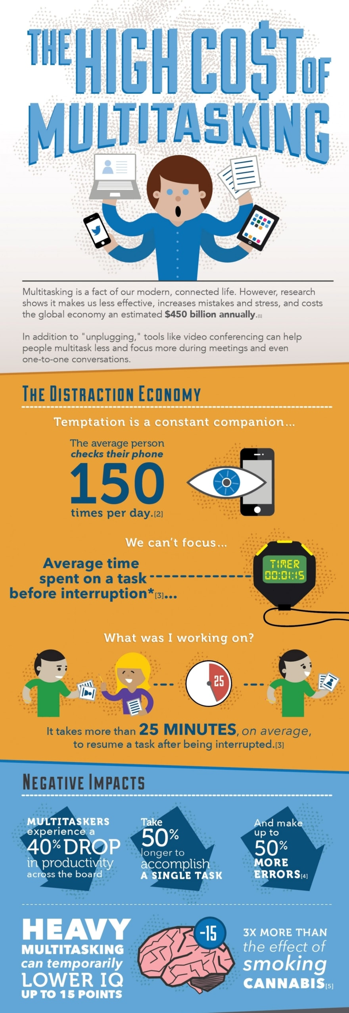
Strategies to Increase Scholarly Productivity
Be efficient/focus
  The myth of multitasking
Getting More Done: Strategies to Increase Scholarly Productivity https://www.ncbi.nlm.nih.gov/pmc/articles/PMC4763375/

Slide 8

What takes your time?
Common distractions:
  Email
  Meetings
  Interruptions
  Procrastination
    Perfectionism
  Others?

Slide 9
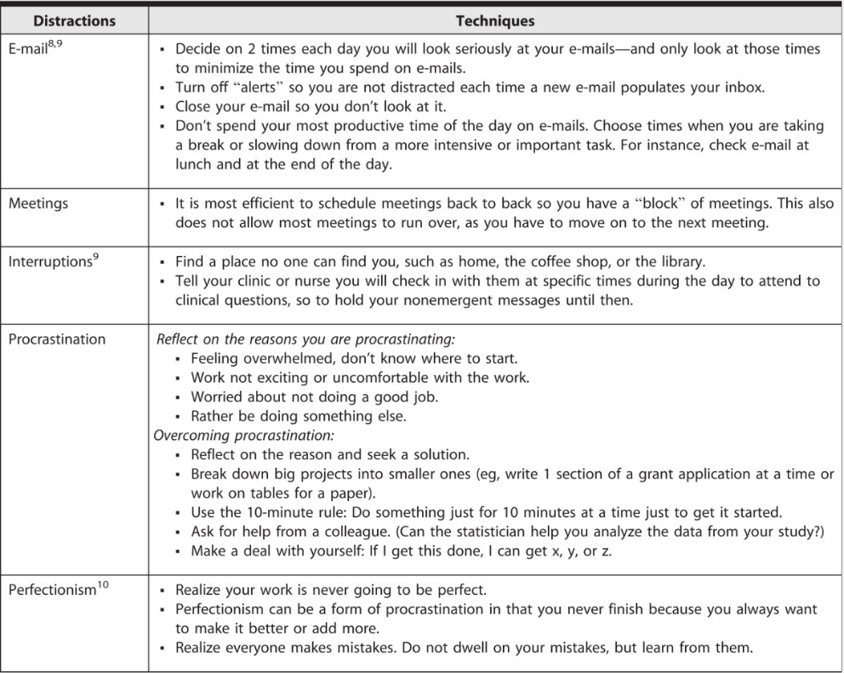
Solutions to Distraction
Getting More Done: Strategies to Increase Scholarly Productivity https://www.ncbi.nlm.nih.gov/pmc/articles/PMC4763375/

Slide 10
Strategies for Increasing Scholarly Productivity
THINK/PAIR/SHARE

Slide 11
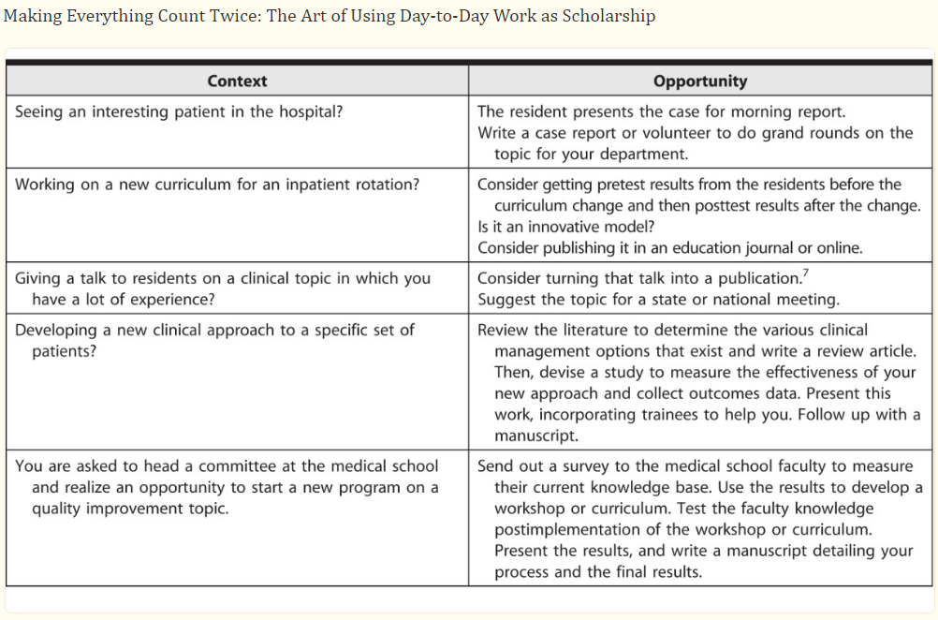
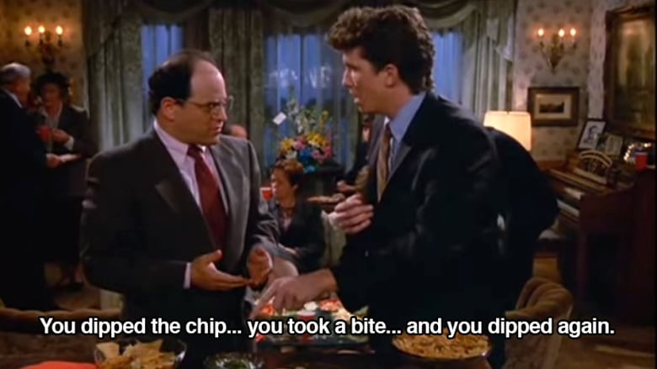

Strategies to Increase Scholarly Productivity
Make things Count twice: The art of using day-to-day work as scholarship
Scholarly Activity is not like chips
Getting More Done: Strategies to Increase Scholarly Productivity https://www.ncbi.nlm.nih.gov/pmc/articles/PMC4763375/

Slide 12
Adapted from Weiser 1996

Slide 13
What is your plan going to be?

