Slide 1
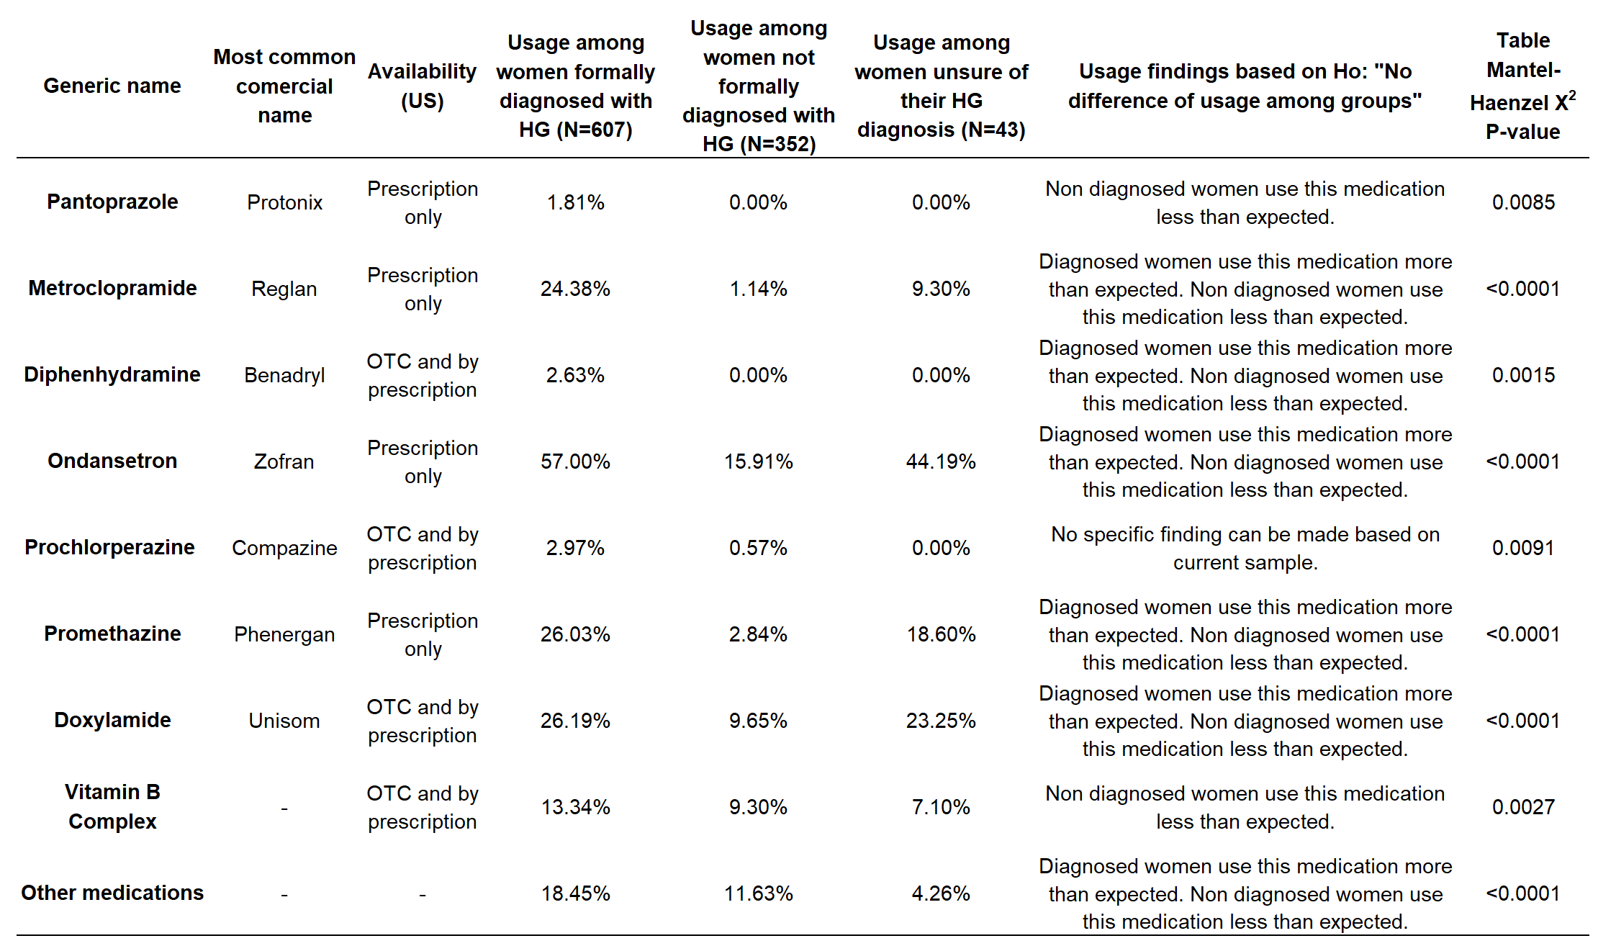
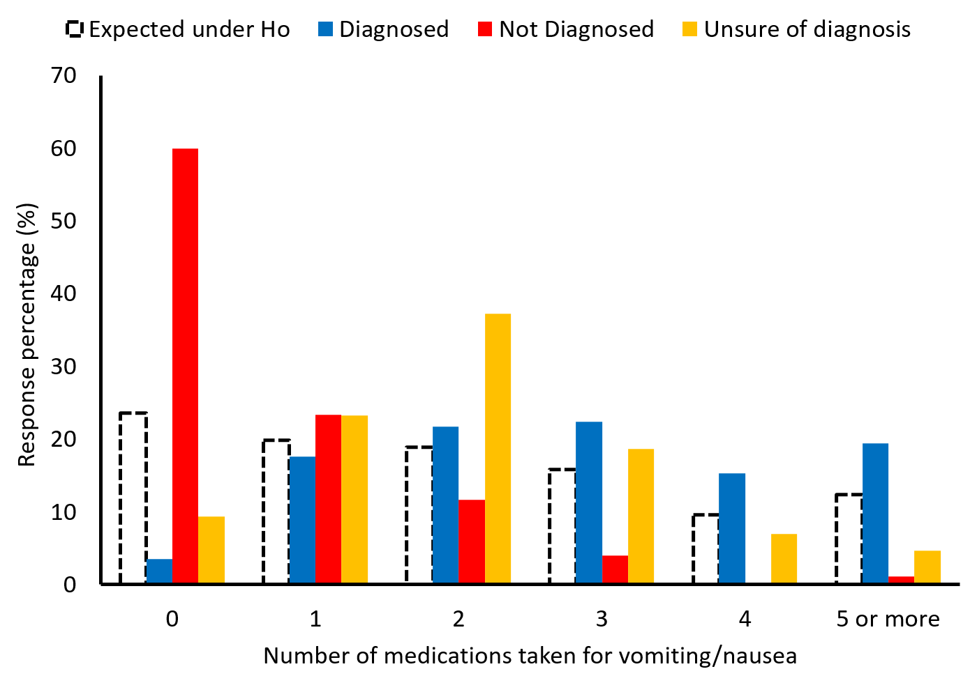
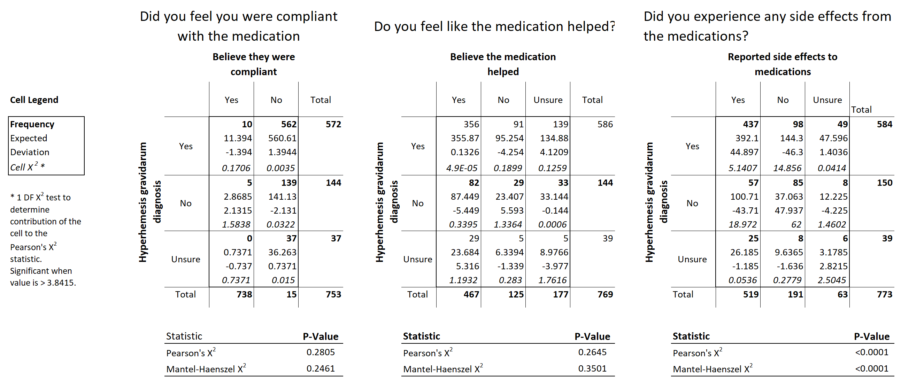
Efficacy of Current Treatment Guidelines for Hyperemesis Gravidarum and Nausea/Vomiting in Pregnancy
INTRODUCTION
RESULTS
Nausea and vomiting in pregnancy (NVP) take place in 50-80% of pregnancies (Grooten, 2016). The most severe form of NVP known as Hyperemesis Gravidarum (HG) occurs in 0.3%–3.6% of pregnancies and has debilitating symptoms (Einarson TR, 2013).
The condition is characterized by intractable vomiting, especially during the first trimester, that is difficult to treat and often leads to hypovolemia and weight loss.
HG is the single largest cause for early pregnancy hospitalization (ACOG practice bulletin). Women with HG are most commonly hospitalized due to weight loss that exceeds 5% of prepregnancy weight, dehydration, electrolyte imbalance, arrhythmias, and acid-base balance disturbance (Popa).
There is currently no consensus on diagnostic criteria (Jennings).
The impact of HG on women's lives has often been trivialized by health care providers [6]. The high prevalence of nausea and vomiting in normal pregnancy and its self-limiting nature has led to a lack of clinical attention, misinterpretation of symptoms, and delayed diagnosis and treatment.
This lack of a unified current standard of care for HG patients prevents the condition from being widely recognized by health care providers and downplays the need for effective interventions.
Table 1 . Medications used by HG diagnosis group (Diagnosed, unsure and undiagnosed)
Figure 1. Number of medications taken for vomiting and nausea among survey respondents.
OBJECTIVE
Figure 2. Self reported experience with the medications used.
Our objective is to identify the subjective efficacy of the management protocol that is currently in place for nausea/vomiting in pregnancy and hyperemesis gravidarum. The data presented in this research will provide insight into the suffering that patients with these diagnoses face day-to-day.
METHODS
The questionnaire was created using the diagnostic criteria used by the HER Foundation. It included questions regarding race, income level, education level, support system, region in which they reside, and employment status. All questions were multiple choice, used Likert scales, and free-response question formats.
The questionnaire was distributed via institutional email, social media (including online HG support groups and personal social media pages), as well as the Hyperemesis Education and Research (HER) Foundation website.
Inclusion criteria for this research included being assigned female sex at birth and birthing a child. Each participant was asked to fill out one survey per child.
Data was evaluated using contingency tables where pair wise association were determined using a Mantel-Haenszel Chi-square tests
CONCLUSIONS
Over 1000 pregnancies were analyzed, and voluntary respondents completed a survey for each living biological child. The survey screened for patients and symptoms congruent with HG, NVP, and asymptomatic as defined by ACOG guidelines.
60.6% were diagnosed with HG. 95.5% experienced nausea, and 87.3% experienced vomiting. 4% were asymptomatic.
This information, including individual pharmacotherapy data, can help us identify risk factors for HG and its widespread effects on patients' lives, which can be helpful for screenings, providing resources to patients, and developing further treatment options.
REFERENCES

