Slide 1
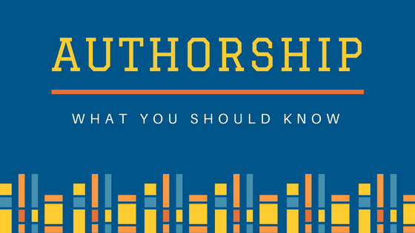
Lunch and Learn: Authorship
Dr. David Forstein
Dr. Amanda Brooks

Slide 2
Distinguish what contributions constitute authorship
Navigate issues of authorship
Identify the responsibilities of authorship

Slide 3
Authorship is important
Why?
Prestige
Legitimizes your work
Promotion
Invitations
Grant awards
Others?

Slide 4
Authorship Defined
Based on 4 criteria:
Substantial contributions to the conception or design of the work; or the acquisition, analysis, or interpretation of data for the work; AND
Drafting the work or revising it critically for important intellectual content; AND
Final approval of the version to be published; AND
Agreement to be accountable for all aspects of the work in ensuring that questions related to the accuracy or integrity of any part of the work are appropriately investigated and resolved.
Notes:
Examples of activities that alone (without other contributions) do not qualify a contributor for authorship are acquisition of funding; general supervision of a research group or general administrative support; and writing assistance, technical editing, language editing, and proofreading. They may also include items such as data collection, providing data, providing patients or animals, providing funding, or providing administrative support

Slide 5
Notes:
Poll Title: Do not modify the notes in this section to avoid tampering with the Poll Everywhere activity. More info at polleverywhere.com/support What activities do not qualify an individual for authorship? https://www.polleverywhere.com/free_text_polls/wGFvts1Qf5lMqI53KJkpk

Slide 6
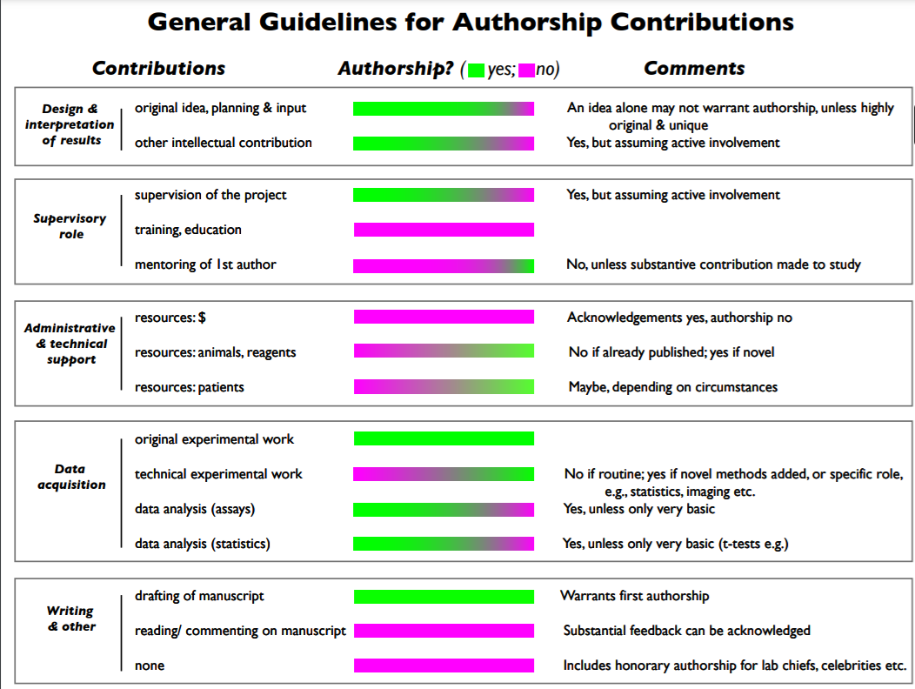
https://oir.nih.gov/sites/default/files/uploads/sourcebook/documents/ethical_conduct/guidelines-conduct_research.pdf

Slide 8
Authorship Order
Item | Author 1 | Author 2 | Author 3 | Author 4 | Author 5 | Author 6
Conception
Experimental Design
Experimental Execution
Data Analysis/ Interpretation
Drafting the Article
Revising/ Reviewing the Article
Public responsibility (score 1 for yes and 0 for no)
Total
A person must have a score in four of the seven items and a minimum total score of 11 to be included as an author.
Everyone should agree to the definitions of minimal, some and significant…
Notes:
Determining individual contribution for authorship (minimal (1 point), some (3 points), significant (5 points), public responsibility (1 point)). A single scale should be filled out for each author to determine the order.

Slide 9
Conflicts over Authorship
Please Share:
Have you ever had a conflict over authorship?

Slide 10
Notes:
Poll Title: Do not modify the notes in this section to avoid tampering with the Poll Everywhere activity. More info at polleverywhere.com/support Who decides if there is a conflict over authorship? https://www.polleverywhere.com/free_text_polls/ILQWMkvP8raxswgaqJats

Slide 11
Authorship Responsibilities
Disclosing Conflicts of interest
All authors are responsible for data integrity
All authors are responsible for data accuracy
All authors should ensure that questions regarding data accuracy or integrity are investigated and resolved

Slide 12
Questions

